Slide 1


AI FACE ATTENDAMCE SYSTEM
PARK COLLEGE OF ENGINEERING AND TECHNOLOGY
KANIYUR, COIMBATORE-641659
Team Members
Jerline Jose. A (712220125001)
Suman. M (712220125002)
Guided by
Dr. E. Mohan Kumar, M.E , Ph.D

Slide 2
CONTENT
INTRODUCTION
WHAT IS FACE DECTECTION ?
WHAT IS FACE RECOGNITION ?
HOW FACE RECOGNITION WORKS
SOFTWARE USED
SYSTEM ARCHITECTURE
FEATURES
SYSTEM GUIS
ADVANTAGES
DISADVANTAGES
RESULT ANALYSIS
FUTURE WORKS

Slide 3
INTRODUCTION
An AI face attendance system revolutionizes the traditional attendance tracking by employing advanced facial recognition technology.
This system efficiently automates attendance marking, offering seamless integration into various organizational setups.
By utilizing deep learning algorithms, it accurately identifies individuals based on facial features, eliminating the need for manual entry

Slide 4
WHAT IS FACE DECTECTION ?
Face detection is a type of computer vision technology that is able to identify people’s faces within digital images or video.
This is very easy for humans, but computers need precise instructions.
The images might contain many objects that aren’t human faces, like buildings, cars, animals, and so on.
Face detection algorithms are designed to scale efficiently, allowing them to process images or video streams in real-time or near real-time, even when dealing with large datasets or high-resolution content.

Slide 5
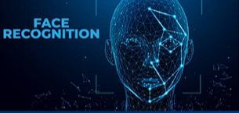
WHAT IS FACE RECOGNITION ?
A facial recognition system is a technology capable of identifying or verifying a person from a digital image or a video frame from a video source. There are multiple methods in which facial recognition systems work, but in general, they work by comparing selected facial features from given image with faces within a database.

Slide 6
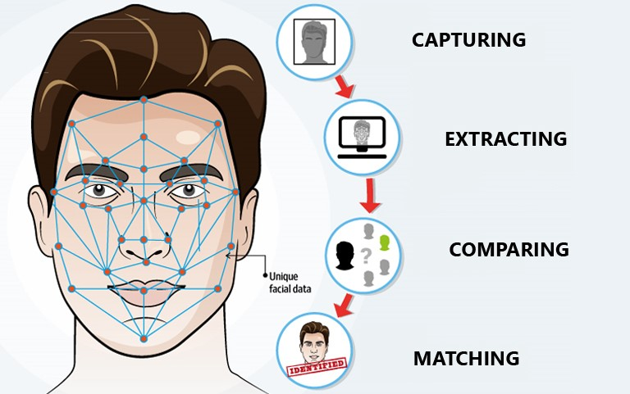
HOW FACE RECOGNITION WORKS
The mathematical algorithms of biometric facial recognition follow several stages of image processing:
Capture: The first step is for the system to collect physical or behavioral samples in predetermined conditions and during a stated period of time.
Extraction: Then, all this gathered data should be extracted from the samples to create templates based on them.
Comparison: After the extraction, collected data is compared with the existing templates.
Matching: The final stage of face detection technology is to make a decision whether the face's features of a new sample are matching with the one from a facial database or not. It usually takes just seconds.

Slide 7


SOFTWARE USED
Program language : Python 3 - Python is a popular programming language. It was created by Guido van Rossum, and released in 1991.
It is used for:
web development (server-side),
software development,
mathematics,
system scripting
Software:
1. Visual Studio Code - also commonly referred to as VS Code, is a source-code editor developed by Microsoft for Windows, Linux and macOS.

Slide 8
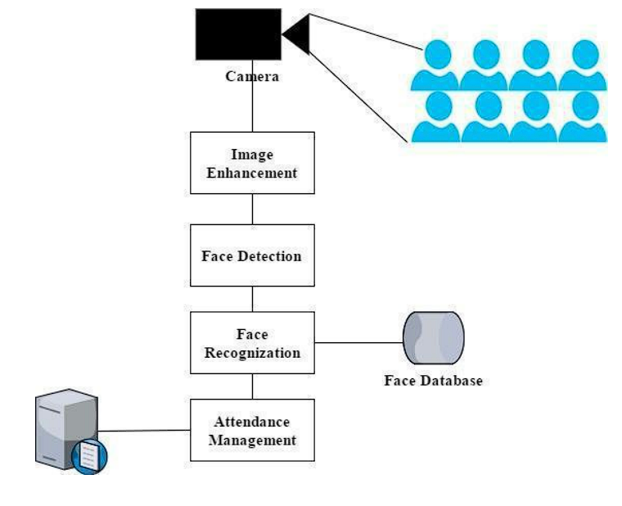
SYSTEM ARCHITECTURE

Slide 9
FEATURES
Face Recognition: The system uses AI algorithms to recognize and identify individuals based on their facial features. This eliminates the need for manual attendance marking and reduces errors.
Accuracy: AI-based systems can achieve high accuracy in recognizing faces, even in varying lighting conditions and different angles.
Real-time Monitoring: The system can track attendance in real-time, allowing administrators to monitor attendance patterns and detect anomalies promptly
Automation: Attendance marking and record-keeping are automated, saving time and effort for both Students and Teachers.

Slide 10
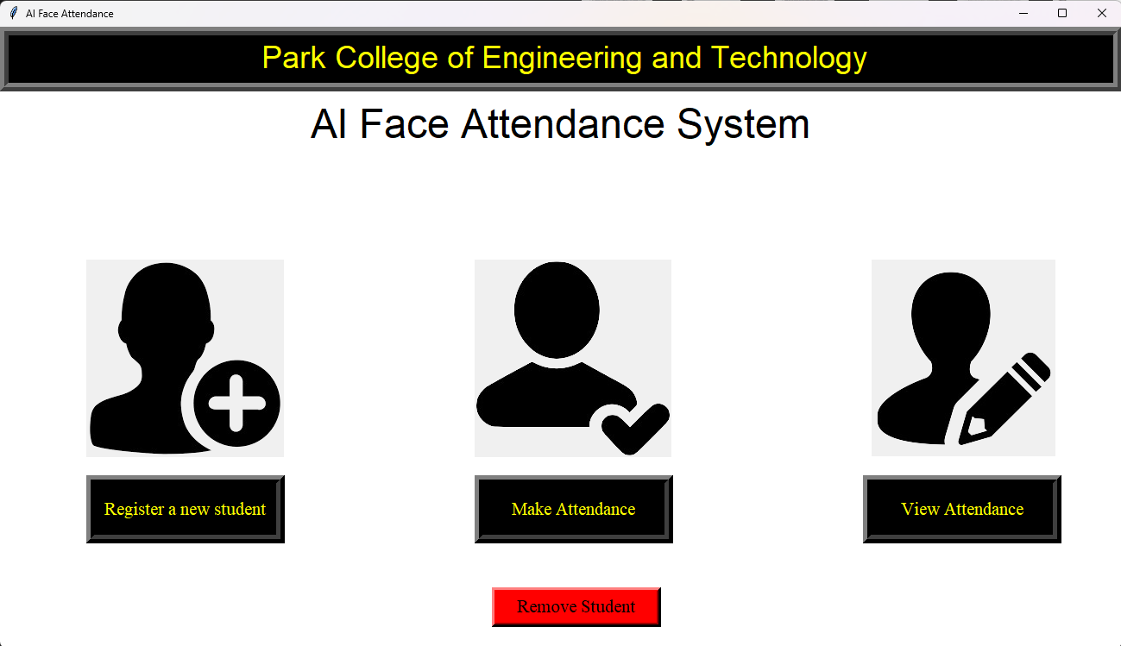
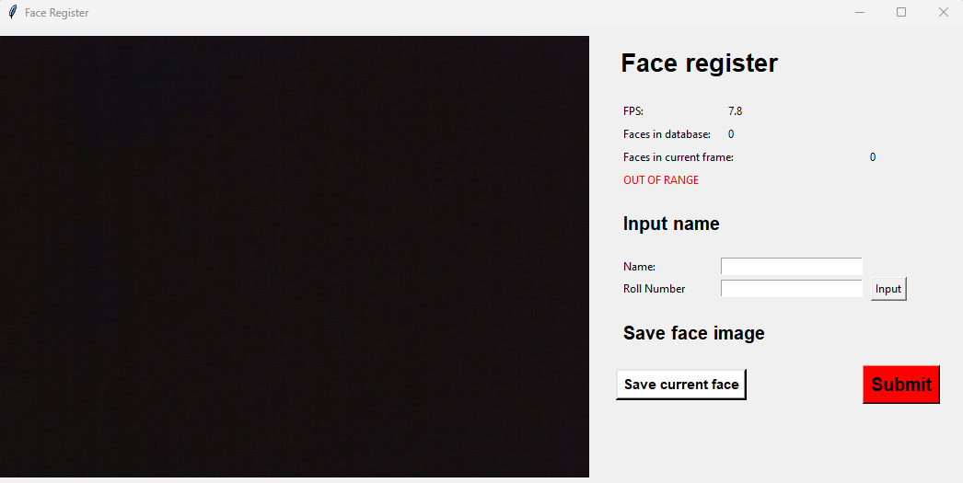
SYSTEM GUI
Main GUI
Face Register GUI

Slide 11
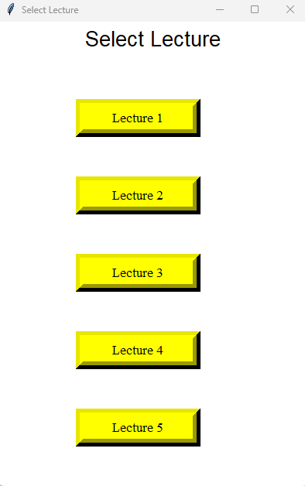
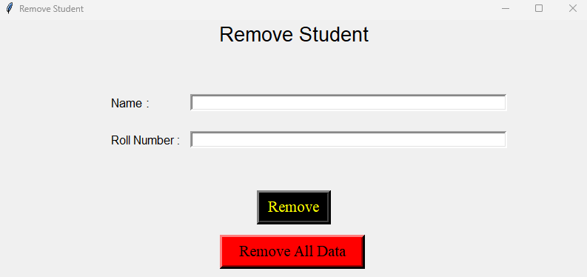
SYSTEM GUI
Selecting Lecture GUI
Remove Student Details GUI

Slide 12
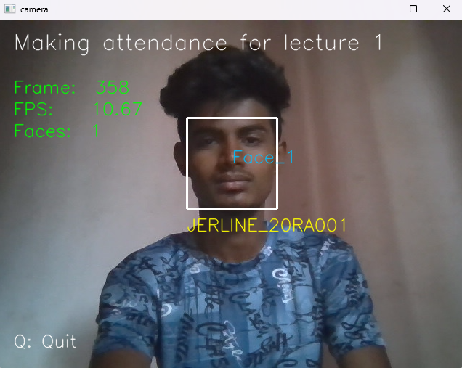
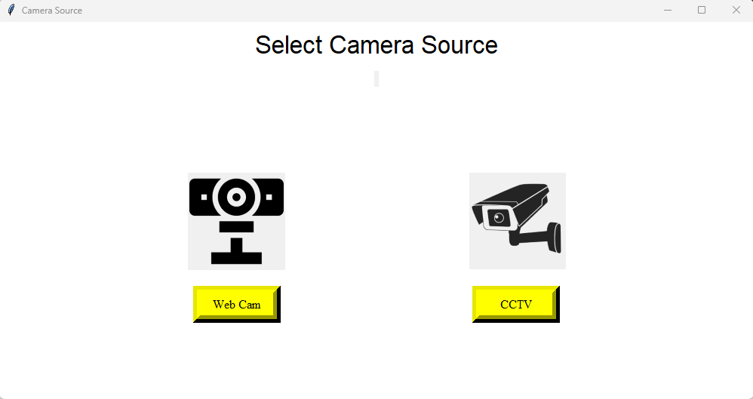
SYSTEM GUI
Select Camera Source GUI
Making Attendance

Slide 13
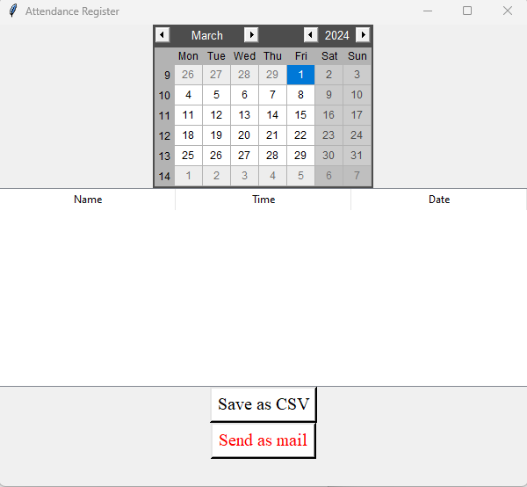
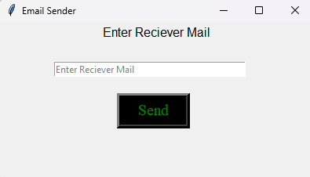
SYSTEM GUI
Attendance GUI
Mail Sending GUI

Slide 14
ADVANTAGES
Accuracy: AI-based face recognition technology can accurately identify individuals, reducing errors in attendance tracking compared to manual or card-based systems.
Efficiency: The system automates the attendance marking process, saving time for both employees and administrators. It eliminates the need for manual data entry and reduces paperwork.
Convenience: Employees can mark their attendance using their faces, eliminating the need for physical devices like ID cards, tokens, or biometric scanners. This is particularly beneficial for organizations with a large workforce.
Real-time Monitoring: The system allows for real-time monitoring of attendance, enabling administrators to track attendance patterns, identify anomalies, and take prompt action if needed.
Scalability: AI face attendance systems are scalable and can handle a large number of users, making them suitable for organizations of all sizes.

Slide 15
ADVANTAGES
Cost-effective: While initial setup costs may be higher than traditional systems, AI face attendance systems can be cost-effective in the long run due to reduced manual effort and improved accuracy.
Analytics: These systems can generate detailed reports and analytics on attendance trends, late arrivals, absenteeism, etc., which can be used for analysis, decision-making, and improving organizational efficiency.

Slide 16
DISADVANTAGES
Technical Challenges: Face recognition technology may face technical challenges such as poor lighting conditions, occlusions (e.g., wearing masks), or variations in facial appearances due to aging or changes in hairstyles. These challenges can affect the accuracy and reliability of the system.
Privacy Concerns: One of the primary concerns with AI face recognition systems is privacy. Employees may feel uncomfortable with their facial data being collected and stored, especially if they are not adequately informed about how the data will be used and protected.
Maintenance and Updates: Regular maintenance, updates, and upgrades are necessary to ensure the optimal performance and security of AI face attendance systems. This requires ongoing investment in resources and expertise

Slide 17
DISADVANTAGES
Bias and Accuracy Issues: AI algorithms used in face recognition systems can exhibit bias, leading to inaccuracies, particularly in recognizing faces of certain demographics, such as people of color or individuals with disabilities. This can result in unfair treatment or exclusion

Slide 18
RESULT ANALYSIS
In our project we have been working more the 1200 pictures. Our result of our project percentages is almost 80-81%. Though it is not enough for this little dataset. To make almost 98% accuracy we need to use more powerful hardware and also need more resources.

Slide 19
FUTURE WORKS
In future, we are going to make our project online. So that this project can be use in bigger area like University, work place , factory etc. And also add the neural network. If we use the neural network we can have more accuracy around 99.9% with big datasets.
Login authentication.
Automation.

Slide 20
Thank you

